Slide 1

Just-in-Time Intervention
Sub Team Presentation-1

Slide 2
Introduction

Slide 3



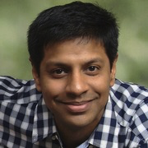
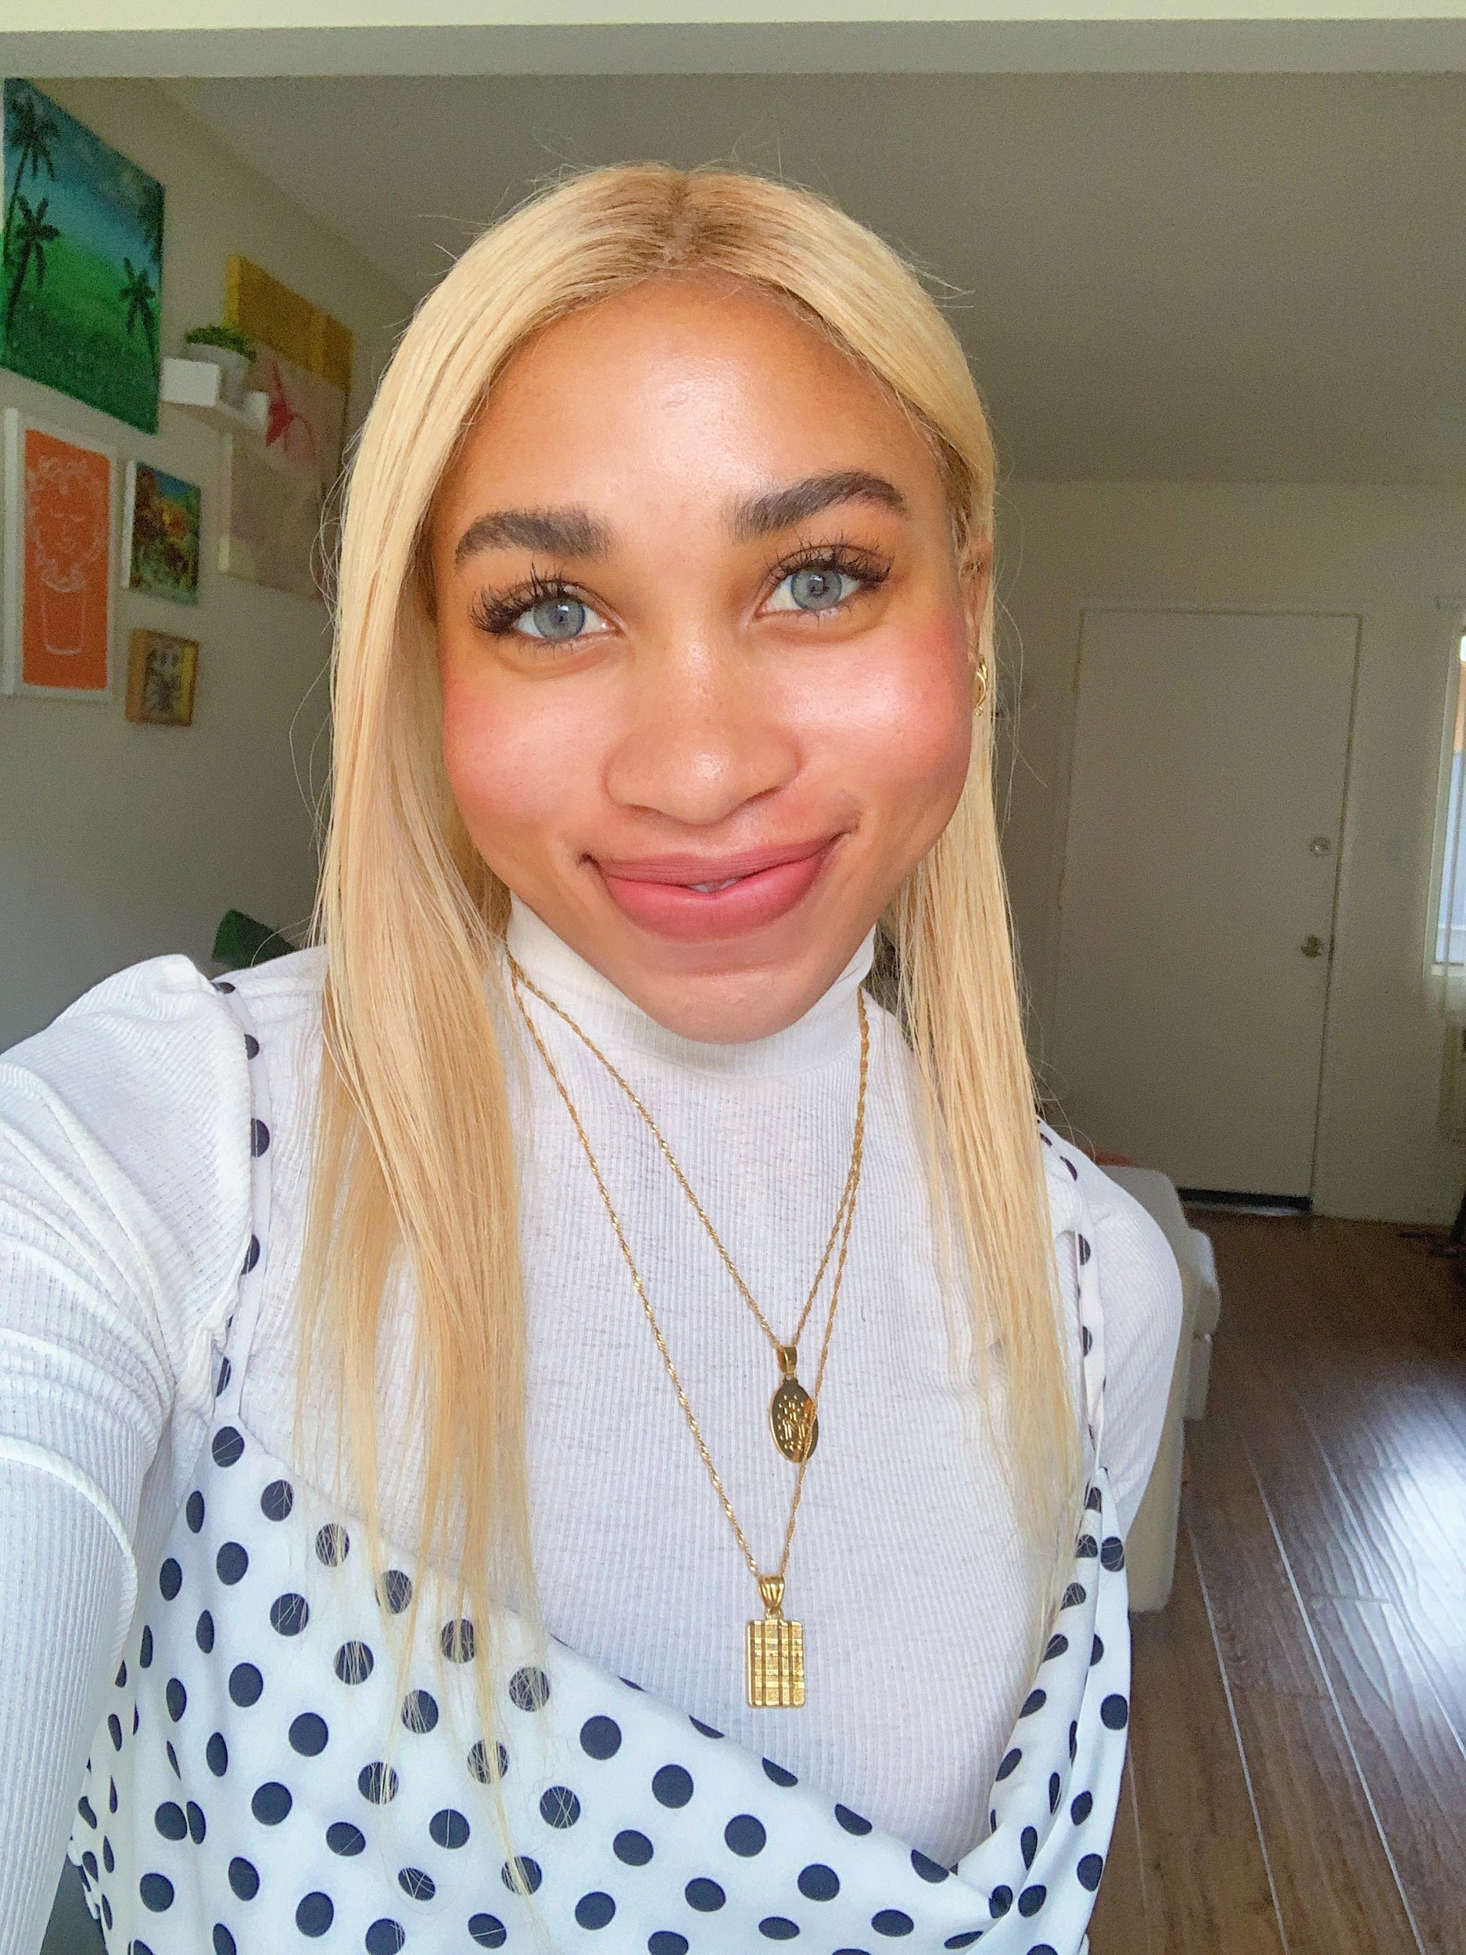

Meet the Team!
Attush
Front-End Developer
Ania
Educational Researcher
Aashay
Web App Engineer
Saurabh
Project Management
Lindsey
Data Engineer
Cindy
ML Engineer

Slide 4
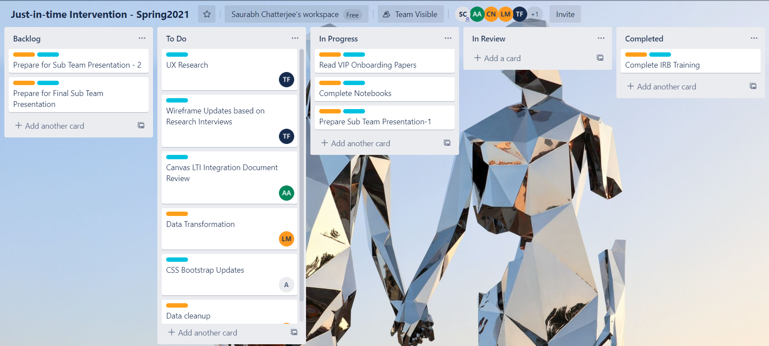
Logistical Accomplishments
❖Split into two-teams based on individual interests
UI/UX Team – Focusing on UX Development and research
ML Team – Focusing on ML Research
❖Setup Teams Channel for communication and sub team meetings.
❖Setup Backlogs in Trello Board and track progress each week.

Slide 5
Background of Project
Project inspired by an analysis conducted by Gardner and Brooks (UMich) in 2018, who laid the framework for attempting to predict student success in MOOCs (https://arxiv.org/abs/1711.06349)
In their paper, they used raw data sources from many MOOCs platforms.
■ Clickstream data
Assignment data
Forum data
We have access to many similar datasets via Georgia Tech’s numerous online courses
Our team’s ultimate goal is to not only gain insight into what drives student success, but also to be able to easily present our results to professors and students so that they can be guided towards success.

Slide 6
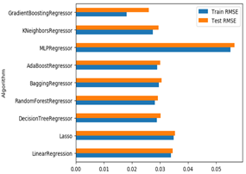
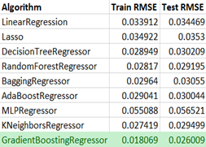
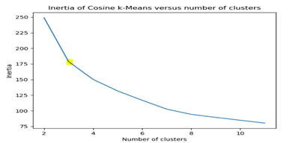
Past Semester Progress- Data Modeling
❖ Model Training Team
➢ Explored data from MOOC Course CS1301 to draw useful insights from completion percentage rates
➢ Data clean-up, Data engineering, Model training and evaluation to predict % complete from clickstream data.
➢ Explored Unsupervised learning techniques on the data set and found interesting clusters

Slide 7
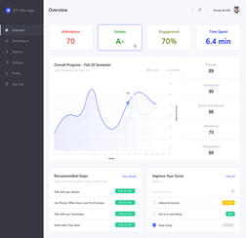
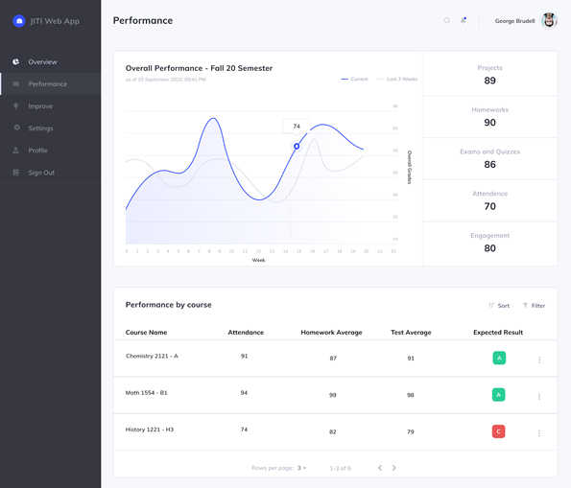
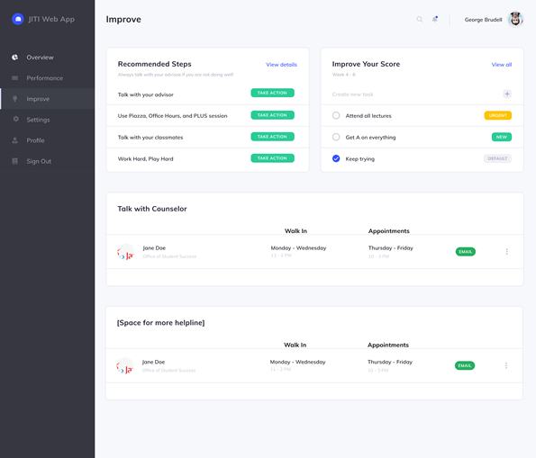
Past Semester Progress – UI/UX
❖ Web Development Team
➢ Massive front-end restructure and building of new wireframes!
➢ Connect web app with C21U DB
➢ New Home page, Resource Page and Analytics Page for a complete experience
➢ Added a completion % prediction page for the model developed by Model Team
➢ Connected to real model to display predicted grade as well as current stats

Slide 8
This Semester..
Goal
➢ Build a web application that predicts student outcome for any given course using a machine learning model.
Outcome
➢ A Minimal Viable Product with LTI authentication that predicts student outcome based on student grades and engagement data (attendance, click stream, log-in duration, etc) for any given course

Slide 9
Data Modeling Team

Slide 10

Data Modeling Team: Goal
Model Evaluation
Time Series
Compare
Goal : Apply predictive modeling techniques from previous semester to new dataset and compare the results of the two course to find correlations and patterns.
Paper: Student success prediction in MOOCs by Gardner & Brooks (University of Washington)
Goal : Evaluate the impact of time series clickstream data on predicting course progress and student success
Paper: Behavior-Based Grade Prediction for MOOCs via Time Series Neural Networks by Tsung-Yen Yang, Christopher Brinton (Princeton University)
Goal : Compare our results with a similar research
Paper: Mass attrition: An analysis of drop out from a Principles of Microeconomics MOOC by Rebecca M Stein and Gloria Allione (University of Pennsylvania)

Slide 11
Data Insights and Clusters
Data Insights
Correlation between null demographics data and Percent Progress
Gender distribution for percent of progress
Demographics Data Insights
Feature Correlation
Unsupervised Learning and Clustering
Explore how the clusters of two courses correlate and is there a pattern we can recognize.
Evaluate how to give better Insights to professors based on cluster analysis

Slide 12
Data Wrangling & Feature Engineering
Data Wrangling
Transform Data for easier manipulation and analysis
Familiarize with most recent data and compare to old data.
Aggregate with data from previous semesters.
Validate and Clean data
Feature Engineering
Explore imputing missing values
Outlier Treatment/Handling
Explore other feature engineering techniques accordingly
Notes:
Data Wrangling
So far we have already started transforming the data for easier analysis by transposing and reorganizing its format,
We will then spend some time getting familiarized with the past and most recent data and compare features from the past data to the new data to find common trends and lookout for any new trends and features that relate to JITI, then aggregating it with data used in previous semesters.
Last steps will involve validating and cleaning the data.
Feature Engineering
Aligned within our data wrangling efforts, we plan on
Possibly impute or drop missing values if necessary.
Identify and drop, cap, re-assign or transform outliers where appropriate.
Continue exploring other feature engineering techniques where essential.

Slide 13
Model Development
Use existing model on new dataset to find how it performs.
Use the model built in previous semester to verify how well it generalizes on a non-STEM course.
Build models and use cross validation to evaluate performance.
Tune hyperparameters using Grid Search
Hidden state
Number of Layers
Epochs
Learning Rate
Decay Rate
Visualize the model predictions
Visualize the effect of model performance over time(week)
Notes:
Since our model from last semester was not in the form of a time series, it was only able to calculate its results after the class has concluded.
This semester we will develop our existing model to allow for results throughout the course so that the student or instructor can receive real time updates on their progress. We want so see if the the model is still efficient in this case.
We also want to test our model on a non stem course to see if the model correlates in class with different objectives. So last semester we were testing on CS course. This semester we will see how it fairs on a management course.

Slide 14
Web Development Team

Slide 15
Web Development Team: Goal
UX Research
Front End
Back End
Goal : Conduct UX Research and improve wireframes
Goal : Improve the look and feel and usability of our app
Goal : Integration with Canvas LTI and connecting with live data/model.

Slide 16
UX Research Plan
Phase One: Conduct UX Research Interview with Sonam Singh
UX Researcher at C21U
Review newest, high-fidelity wireframe
Does the current UX design emphasize Learnability, Efficiency, Usability, and Memorability?
Phase Two: Update wireframes to align with research outcomes
Using Wednesdays interview feedback, final wireframe updates will be made
Phase Three: Implement wireframe changes
Front End Team will begin implementing front end updates to match updated wireframe

Slide 17
Front-end Plans
Modify bootstrap css to match wire frames.
Build pages that are missing from wireframes. (Auth, Advising page)
Work on aesthetics to match the wireframe
Add model query functionality for models developed by Model Team

Slide 18
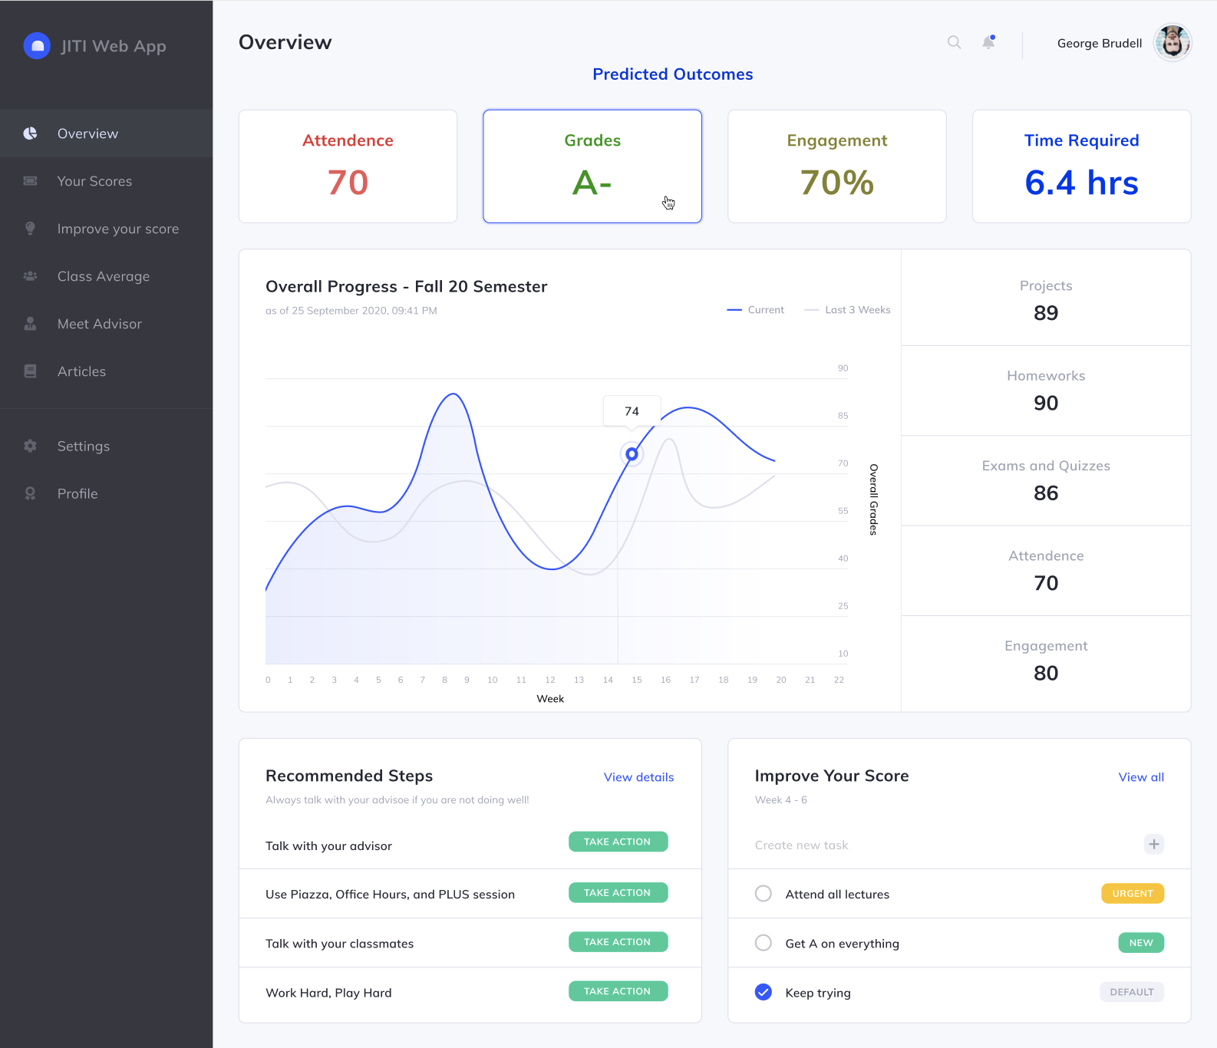

Slide 19


Slide 20
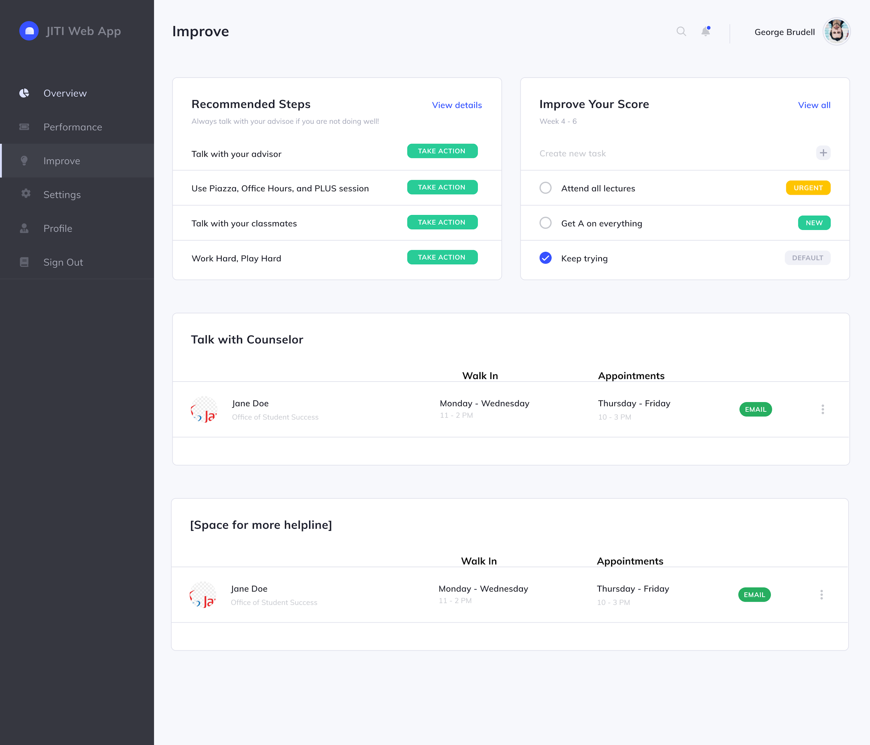

Slide 21
Backend Development
Canvas LTI integration (spent time reading documentation)
Authentication - configure application to be able to accept post requests, create a request validator, etc.
Considering making backend Django as there are tools to help with this
Creating classes for models
Unfinished work from last semester. Encapsulating models into classes - time needed to learn best practices for this
Possibly placing models in S3 buckets to allow for scalability (reach)

Slide 22
Conclusion
Model-training team
Compare behavioral patterns to predict student outcome for a STEM and Management course
Build a time series prediction model to predict path forward from point of time data.
Provide a mechanism for the front end to query what-if scenarios for a student for a given week.
Web Development Team
➢ Research UX changes to improve wireframes
➢ Implement wireframes to frontend
➢ Implement LTI Integration for login flow
➢ Implement querying of model and what-if scenarios for a student for a given week

Slide 23
Resources
General Resources
“Student Success Prediction in MOOCs” by Josh Garner and Christopher Brooks: https://arxiv.org/abs/1711.06349
ML Research Resources
“Behavior-Based Grade Prediction for MOOCs via Time Series Neural Networks” by Tsung-Yen Yang, Christopher Brinton(Princeton University): https://ieeexplore.ieee.org/document/7917237
“Mass attrition: An analysis of drop out from a Principles of Microeconomics MOOC” by Rebecca M Stein and Gloria Allione(University of Pennsylvania): https://economics.sas.upenn.edu/sites/default/files/filevault/14-031.pdf
UX Research Resources
“UX Wireframing: Bedrock of Interface Usability” by Tubik Studio: https://uxplanet.org/ux-wireframing-bedrock-of-interface-usability-7e9c76bd804d
“5 Usability Design Tips For A Better UX Design” by Ayat Shukairy: https://www.invespcro.com/blog/usability-design-for-a-better-user-experience/

Slide 24
Thank you!!

